Slide 1




Application Program Interface
(API)

Slide 2

API
An API is a set of routines, protocols, and tools for building software applications.
You must have API Keys.

Slide 3
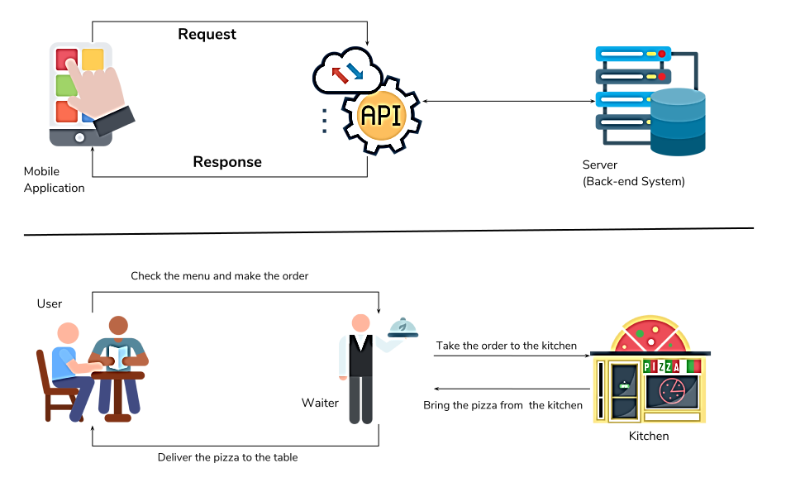
API cont. . .

Slide 4
API cont. . .
Fetching data from the internet is necessary for most apps. Dart and Flutter provides http package to use http resources.
This package contains a set of high-level functions and classes that make it easy to consume HTTP resources.
The http package uses await and async features and provides many high-level methods such as read, get, post, put, head, and delete methods for sending and receiving data from remote locations.
The http package also provides a standard http client class that supports the persistent connection. This class is useful when a lot of requests to be made on a particular server. It should be closed properly using the close() method.

Slide 5
API cont. . .
The core methods of the http package are as follows:
Read: This method is used to read or retrieve the representation of resources. I
Get: This method requests the specified url from the get method and returns a response as Future<response>.
Post: This method is used to submit the data to the specified resources.
Put: This method is utilized for update capabilities.
Head: It is similar to the Get method, but without the response body.
Delete: This method is used to remove all the specified resources.

Slide 6
API cont. . .
API recipe uses the following steps:
Add the http package.
Make a network request using the http package.
Convert the response into a custom Dart object.
Fetch and display the data with Flutter.

Slide 7
Add the http Package
To install the http package, add it to the dependencies section of the pubspec.yaml file. You can find the latest version of the http package the pub.dev.
dependencies:
http: ^0.13.4
Import the http package.
import 'package:http/http.dart' as http;
Additionally, in your AndroidManifest.xml file, add the Internet permission.
<uses-permission android:name="android.permission.INTERNET" />

Slide 8
Using Make a Network Request
Future<http.Response> fetchWeather() async {
return await http.get(Uri.parse(' api.openweathermap.org/data/2.5/weather?q={city name}&appid={API_key}'));
}
Future is a core Dart class for working with async operations.
The http.get() method returns a Future that contains a Response.
The http.Response class contains the data received from a successful http call.

Slide 9
Getting the Response Code & Body
Get the response body
response.body
Get the response code
response.statusCode
HTTP response codes:
Informational responses (100–199)
Successful responses (200–299)
Redirection messages (300–399)
Client error responses (400–499)
Server error responses (500–599)

Slide 10
Getting the Response Code & Body cont. . .
Future<Post> fetchPost() async {
final response = await http.get( Give the link of JSON file');
if (response.statusCode == 200) {
// If the server returns an OK response, then parse the JSON.
return Post.fromJson(json.decode(response.body));
} else {
// If the response was umexpected, throw an error.
throw Exception('Failed to load post');
}
}

Slide 11
Fetch the Data with Flutter.
You can call the fetch method in the initState()
class _MyAppState extends State<MyApp> {
Future<Post> post;
@override
void initState() {
super.initState();
post = fetchPost();
}

Slide 12
Display Data
Finally, display the data. You can display the data by using the FutureBuilder widget. This widget can work easily with async data sources.
FutureBuilder<Post>(
future: post,
builder: (context, abc) {
if (abc.hasData) {
return Text(abc.data.title);
} else if (abc.hasError) {
return Text("${abc.error}");
}
return CircularProgressIndicator(); // By default, it show a loading spinner.
}, );

Slide 13

Thank
You !

